Slide 1
Arithmetic Sequence
Lesson 10-1
https://www.youtube.com/watch?v=j0inU5h9rA8

Slide 2
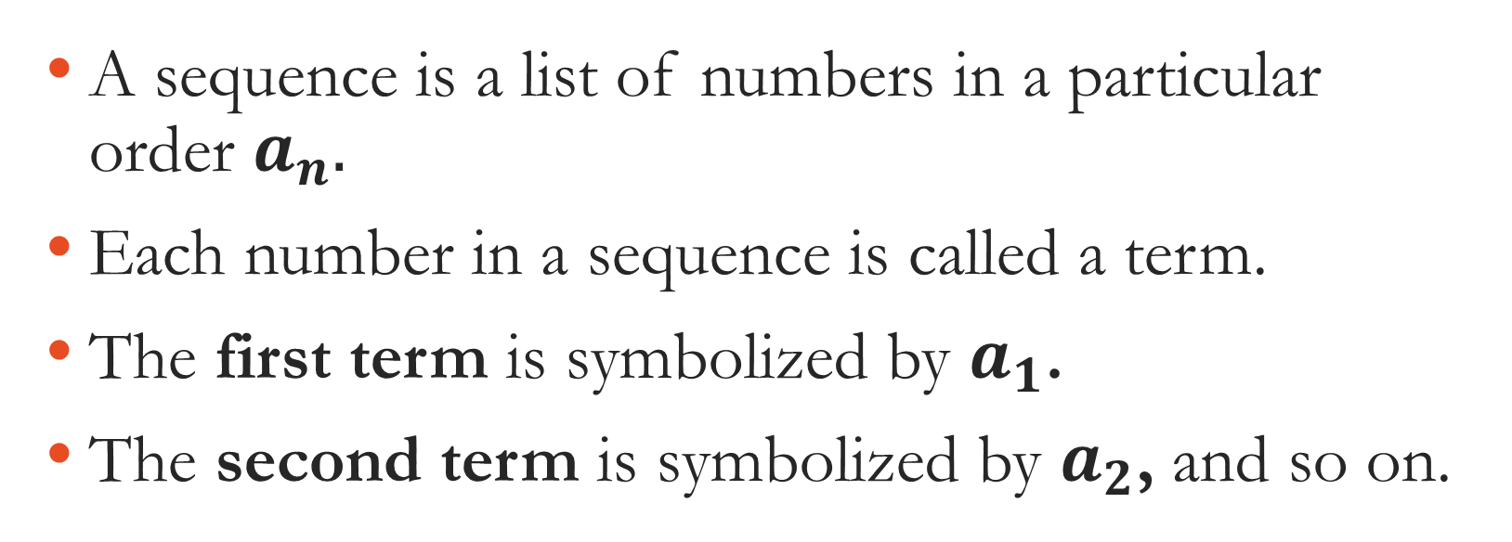
What is a Sequence?
A sequence is a list of numbers in a particular order $a_{n}.$
Each number in a sequence is called a term.
The first term is symbolized by $a_{1}$.
The second term is symbolized by $a_{2}$, and so on.

Slide 3

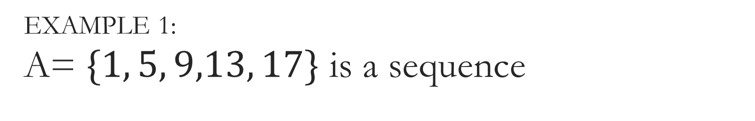
EXAMPLE 1:
A= $\{1, 5, 9,13, 17\}$ is a sequence
$a_{1}=$
$a_{3}=$
$a_{1}+a_{3}=$
$a_{4}−\frac{a_{2}}{5}=$
$\sqrt{a_{3}}=$

Slide 4
Types of Sequence
There are two major types of sequences:
Arithmetic
geometric.

Slide 5
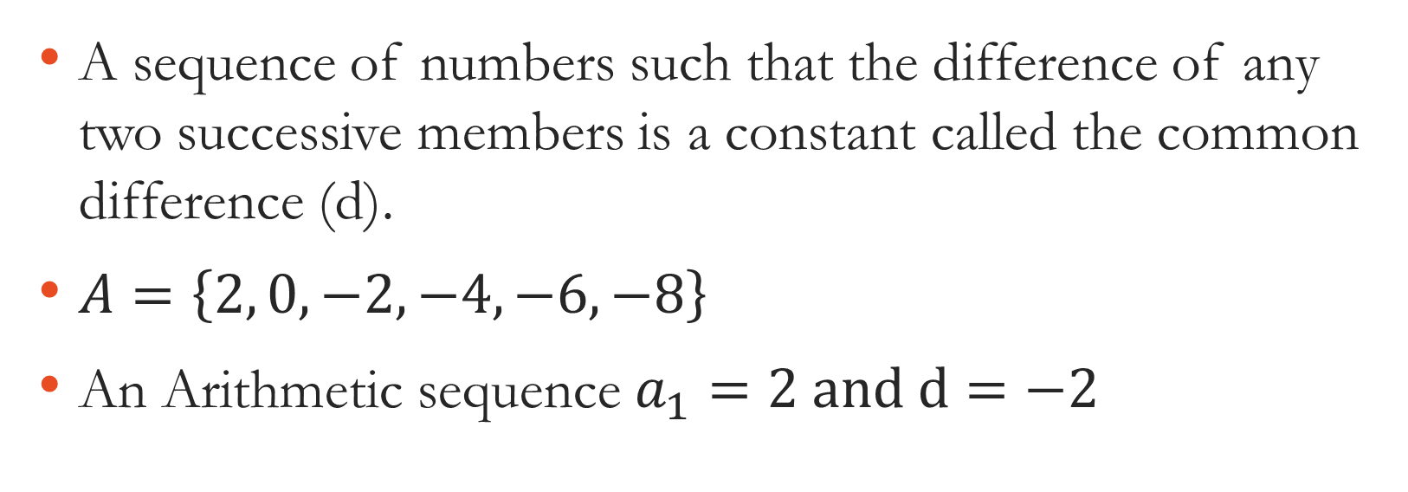
Arithmetic Sequences
A sequence of numbers such that the difference of any two successive members is a constant called the common difference (d).
$A=\left\{2, 0,−2,−4,−6,−8\right\}$
An Arithmetic sequence $a_{1}=2 and d=−2$

Slide 6
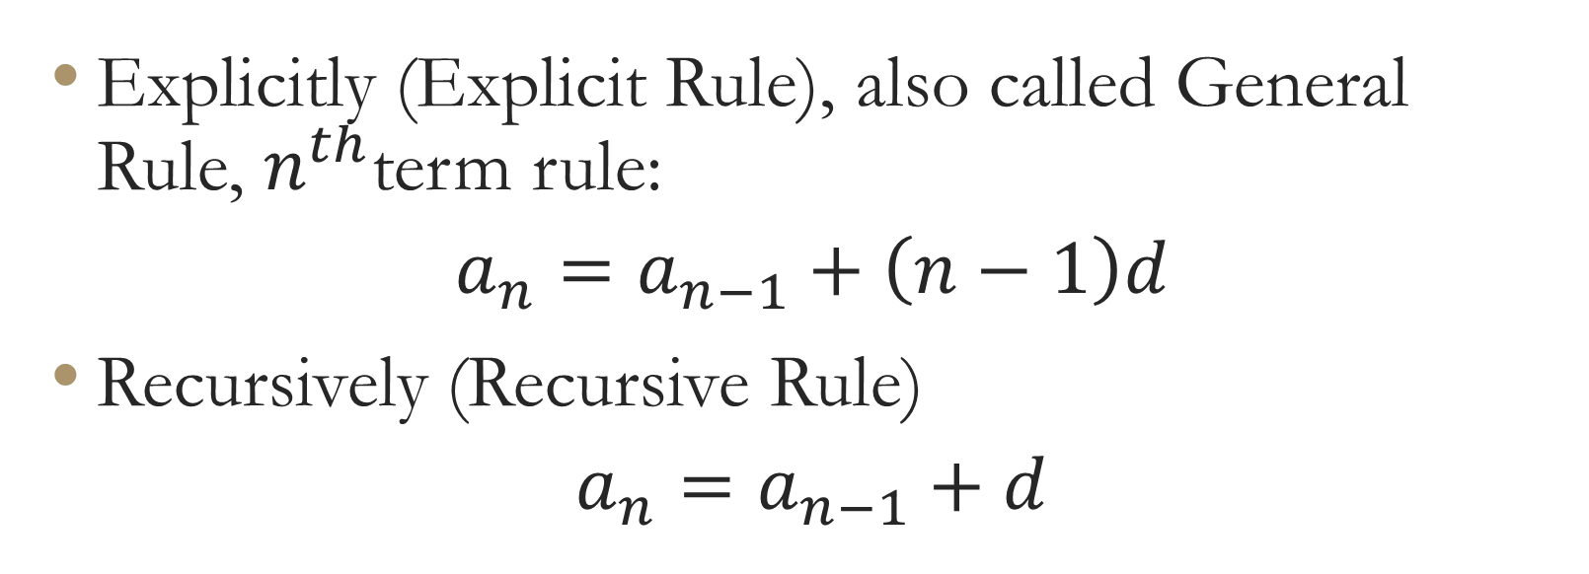
Rules for arithmetic sequences:
Explicitly (Explicit Rule), also called General Rule, $n^{th}$term rule:
$$a_{n}=a_{n−1}+\left(n−1\right)d$$
Recursively (Recursive Rule)
$$a_{n}=a_{n−1}+d$$

Slide 7

List the first 5 terms of the following sequence
$a_{n}=3+\left(n−1\right)2$

Slide 8

List the first 5 terms of the following sequence
$a_{n}=a_{n−1}+6, { a}_{1}=−2$

Slide 9

Write the arithmetic or the nth term rule for the sequence explicitly and recursively:
A= $\{1, 5, 9,13, 17\}$

